Slide 1
Antioxidant Capacity Assay for the Zivkovic’s Lab
12/1/22

Slide 2
Antioxidant Capacity Assay
Do is yourself (Cell-free)
Dihydrorhodamine 123 (DHR)-based (Fluorescence)
Measures HDL Anti-Oxidative capacity
$410/several_96well_assays
ROS indicator
2.5 - 15 ug (cholesterol)
HDL isolated by FPLC
485/538 nm excitation/emission
Pros: Cheap, published method, validated
Cons: DHR oxidizes when exposed to air linearly between 10 and 50 min
Kit based (Cell-free)
Total Antioxidant Capacity Assay Kit (Sigma, Catalog: MAK187-1KT)
($532/100 tests)
Colorimetric
Copper based: Cu2+ ion is converted to Cu+, then Cu+ chelates with colorimetric probe
Sample Volume: 0.01 – 1 uL serum
90min incubation
Pros: Quick and relatively easy
Cons: Will this work with isolated HDL? Copper treatment will interfere with assay

Slide 3
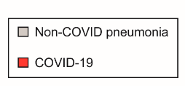
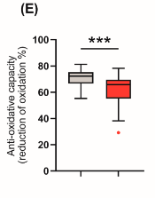
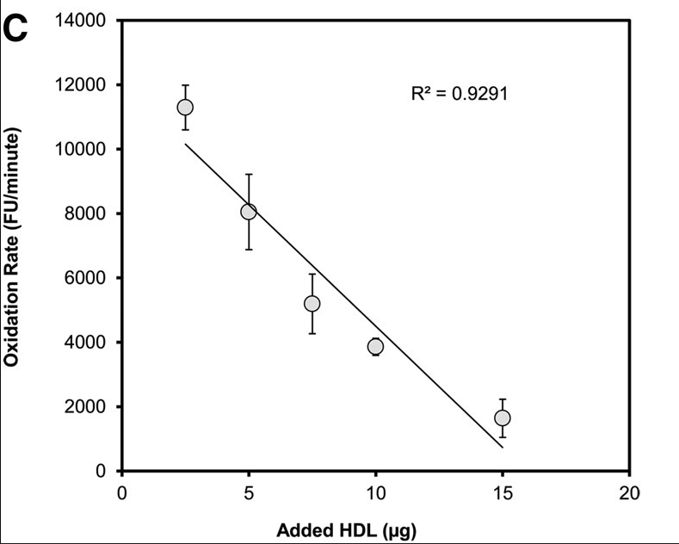
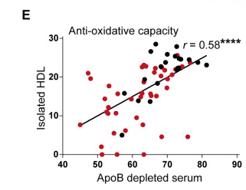
DHR-based assay
Trakaki/Marsche, 2019
HDL isolation: Two-step density gradient
Kelesidis, 2011 JLR
HDL isolation: FPLC
Stadler/Marsche, 2022
1 uL apoB-depleted serum

Slide 4
PON1 Activity
Do is yourself (Cell-free)
Ca2+ dependent PON activity
$165/several_96well_assays
PON activity is measured by the hydrolysis of paraoxon into 4-nitrophenol
Absorbance (405 nm)
10 ug HDL protein
HDL isolation by density gradient
Pros: Cheap, published method
Cons: Paraoxon is cheap, but toxic
Kit-based (Cell-free)
Paraoxonase 1 Activity Assay Kit (ab241044)
$600/100tests
Sample volume: 2-10uL serum/plasma
Fluorescence: EX/Em = 368/460 nm
10min incubation
Pros: Less dangerous toxic substrate, quick and relatively easy
Cons: Will this work with isolated HDL?

Slide 5
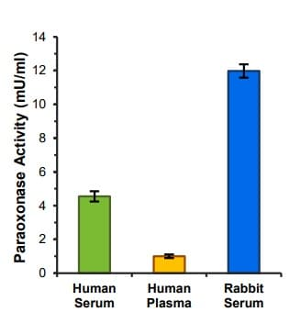
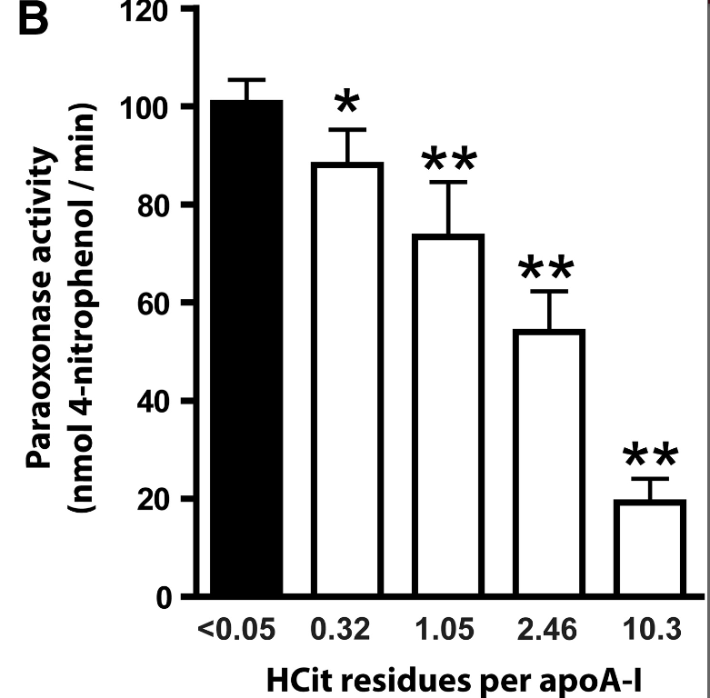
Holzer/Marsche 2012
Carbamylation decreases HDL PON activity
HDL isolation: Density Gradient
HDL used: 20, ug/mL
Abcam kit

